Slide 1
D-310 Unit 1: Common Responsibilities and Procedures

Slide 2
Objectives
Students will be able to:
Describe the main responsibilities of the Expanded Dispatch Support Dispatcher (EDSD).
Describe the various functional relationships in the incident support organization.
Identify factors for effective communication.
Discuss the EDSD’s limits of authority within the expanded dispatch organization.
Identify factors for managing stress.

Slide 3

Incident Position Standards Alignment
This unit aligns with the EDSD Incident Position Standards located at
https://www.nwcg.gov/positions/expanded-dispatch-support-dispatcher/standards-and-references.

Slide 4
Activity: Incident Position Standards
Work individually to answer the questions on the next slide.
Use the NWCG Incident Positions Standards for Expanded Dispatch Support Dispatcher, PMS 350-58 to find your answers.
You have 10 minutes to complete the activity.

Slide 5
Activity Questions
Prior to an assignment, you should ensure access to which programs?
Who should you be in communication with on assignment?
Where can you find an initial briefing checklist for EDSDs?
What resource can be used to help you incident pay guidelines?
What resources are available to help increase situational awareness about your assignment?

Slide 6
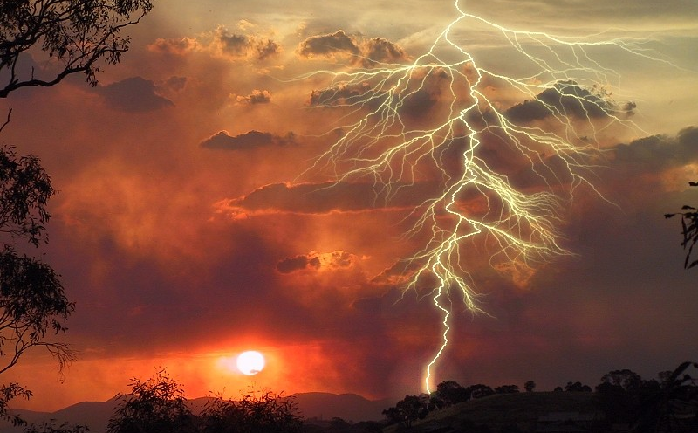
There Was Lightning

Slide 7
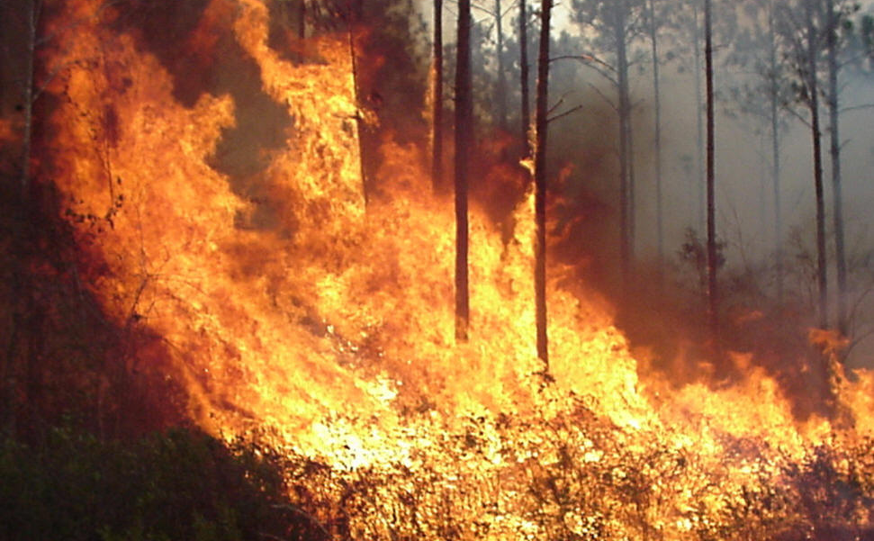
Which Ignited Fire

Slide 8
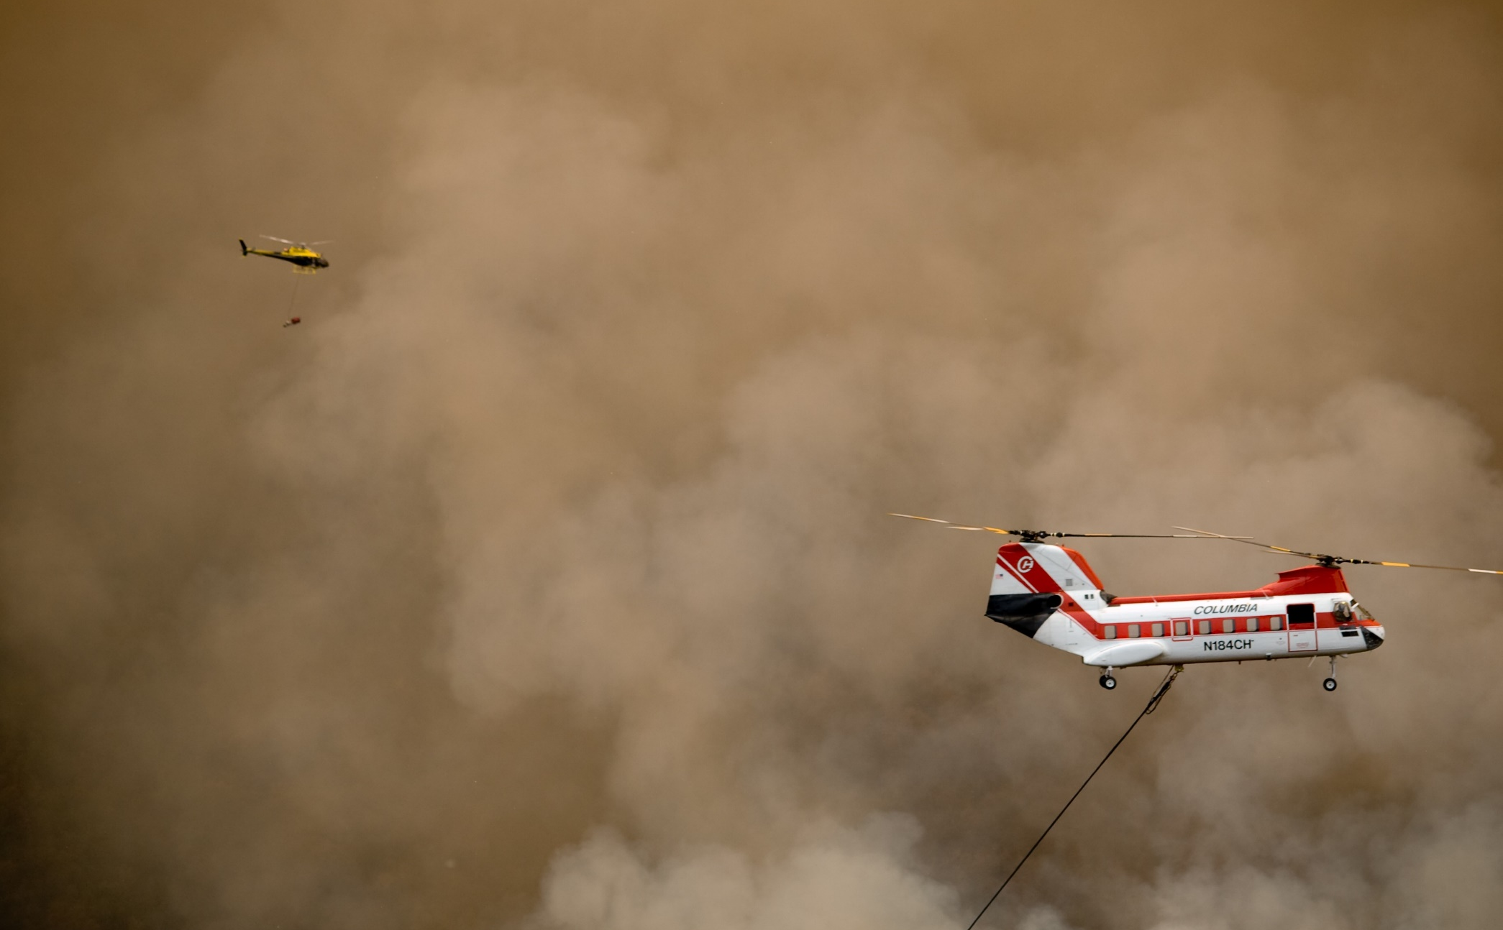
Helicopters Arrived

Slide 9
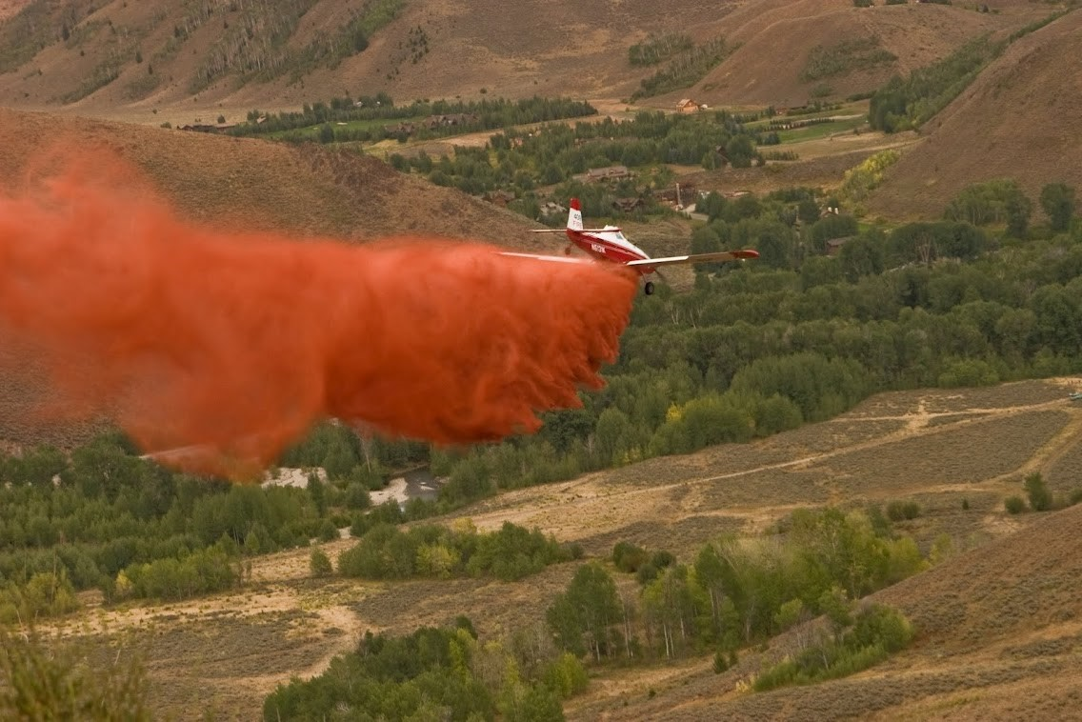
Airtankers Arrived

Slide 10
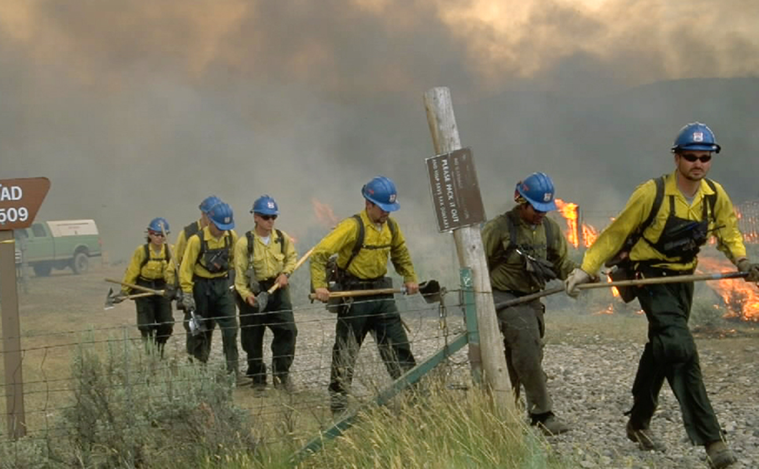
Fire Crews Arrived

Slide 11
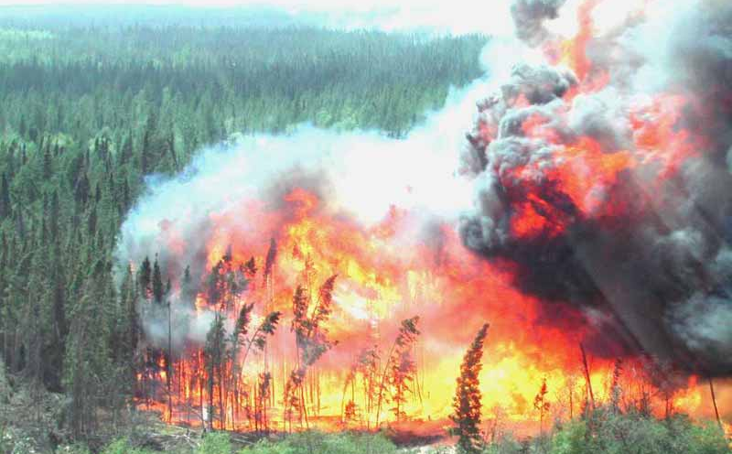
THE FIRE RAGED!

Slide 12
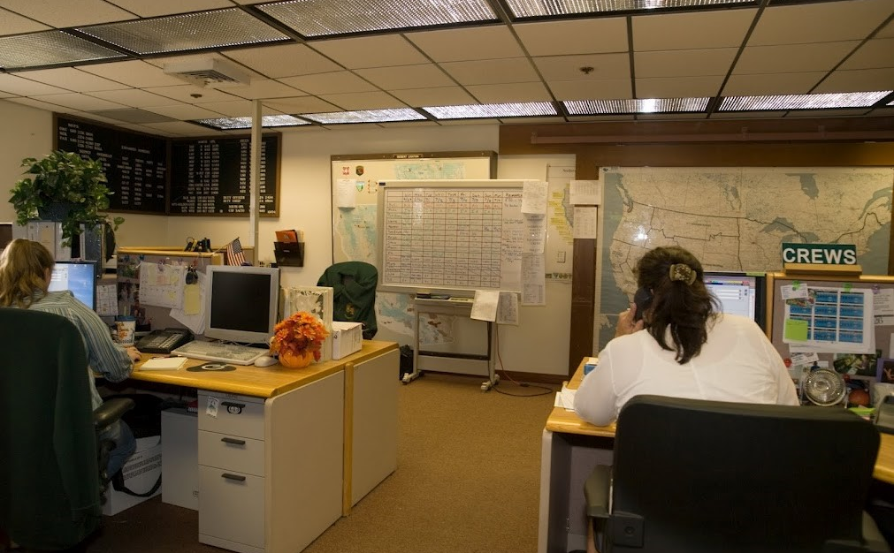
Expanded Dispatch Is Established

Slide 13
Example: Expanded Dispatch Organization
EDSP
EDSD
EDSD
EDSD
EDRC
EDRC
EDRC
EDSD
EDRC
Key
EDSP – Expanded Dispatch Supervisory Dispatcher
EDSD – Expanded Dispatch Support Dispatcher
EDRC – Expanded Dispatch Recorder

Slide 14
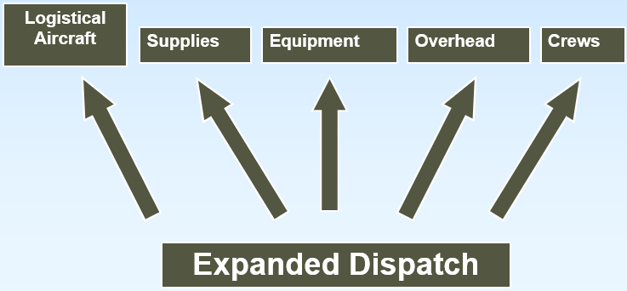
Expanded Dispatch Functional Organization

Slide 15
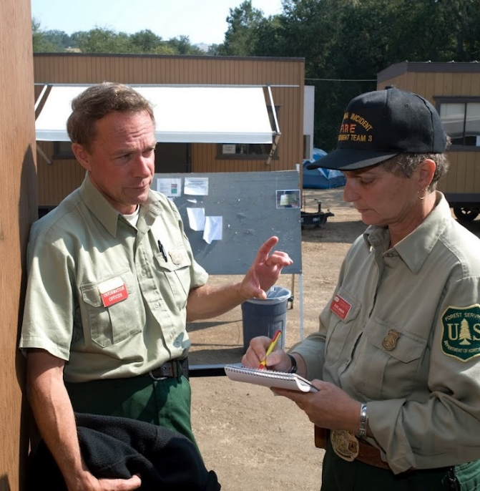
EDSD Main Responsibilities
You are on your way to your EDSD assignment.
What are your main responsibilities?
What should you do first?

Slide 16
EDSD Main Responsibilities
Prepare and Mobilize
Ensure individual readiness.
Gather critical information pertinent to the assignment.
Travel to and check in at assignment.
Notes:
Ensure individual readiness.
Build a kit
PTB
Red Card
Office supplies
Documentation forms—Anything agency specific
Laptop
Credit card—it’s best to be self sufficient, but if this is not an option, talk to the host unit to see if they can accommodate you.
Prepare for absence from home/family. Refer to A Preparedness Guide for Wildland Firefighters and Their Families, PMS 600.
Ensure current access to home dispatch, FireNet, IROC, WildCAD-E, and email (FireNet).
Gather Critical info
Acquire resource order.
Obtain travel itinerary.
Mode of Travel
ETD/ETA/RON
Gather situational awareness.
Get the Incident Action Plan (IAP), if available.
Gather weather information.
Travel to & check into assignment
Follow agency-specific air and ground travel guidelines.
Air travel considerations
Ground travel considerations
Follow agency policy for driver duty day limitations
Ensure NERV/POV/AOV approved
Model professionalism for both internal and external customers.
Wear appropriate attire—some centers may have dress codes
Consistently demonstrate positive attitude

Slide 17
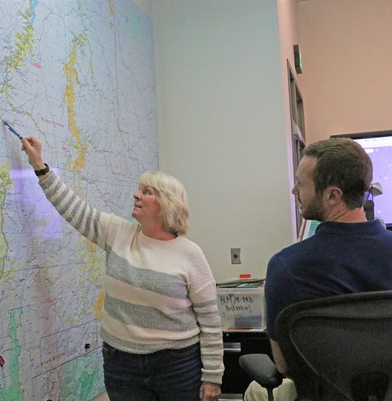
EDSD Main Responsibilities
Build the team
Obtain briefing from supervisor and/or previous shift/assignment.
Notes:
Redmond, Oregon Dispatch Center | Redmond, Oregon Two dispat… | Flickr

Slide 18

Activity: Team Building
Notes:
2025 Photo National Dispatch Academy

Slide 19
EDSD Main Responsibilities
Supervise and Direct Work Assignments
Mentor subordinates and/or trainees.

Slide 20
EDSD Main Responsibilities
Perform EDSD-Specific Duties
Obtain situational awareness.
Review and manage existing requests.
Receive and manage new requests.
Communicate and manage resources in preparation for reassignment or demobilization.
Perform effectively in each of the four functional areas.

Slide 21
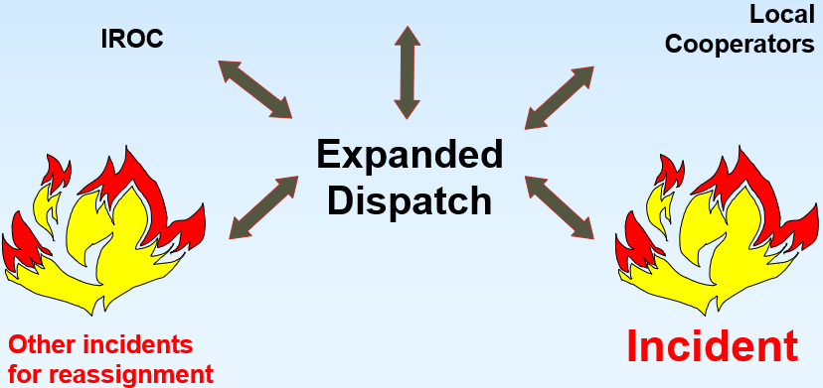
Local Fill
Other Dispatch Centers Accessible Through Local Agreements
Neighbors

Slide 22
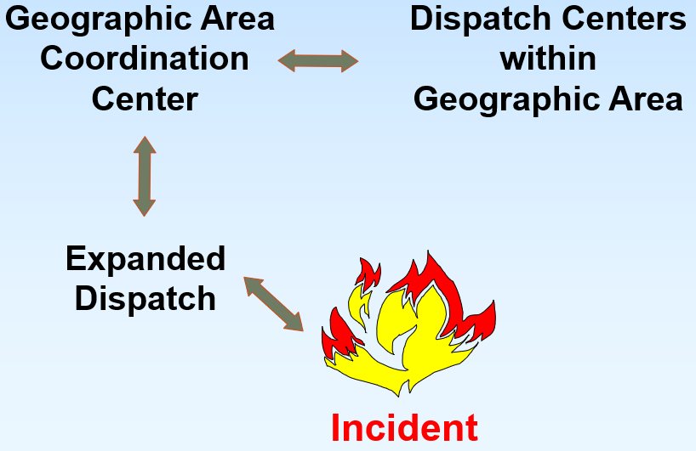
Within the Geographic Area
Notes:
Make it clear that the expanded dispatch should shop their neighboring dispatch centers prior to placing orders to the GACC.

Slide 23
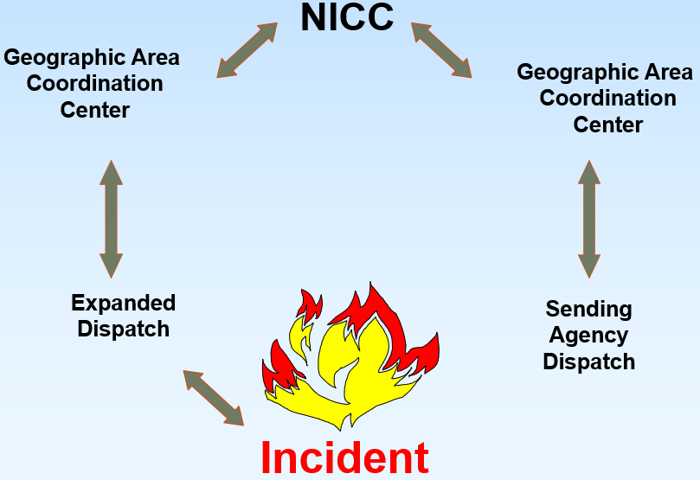
Outside the Geographic Area

Slide 24
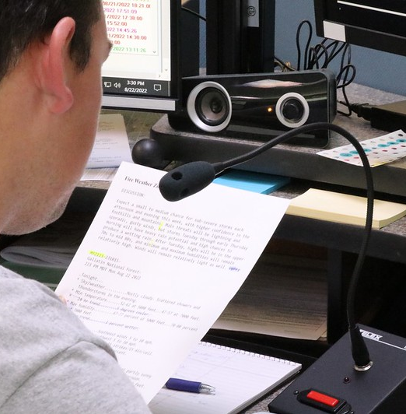
EDSD Main Responsibilities
Communicate and Coordinate
Establish and maintain communication with frequent contacts.
Participate in and/or conduct briefings and/or AARs.
Notes:
Establish and maintain communication with frequent contacts.
Familiarize yourself with daily logs/shift briefs.
Establish communication and working relationships with frequent contacts:
Other dispatch centers, including the GACC and NICC
Functional area (Overhead, Crews, Equipment, and Supplies)
BUYT members (when a BUYT is assigned)
Participate in and/or conduct briefings and/or After Action Reviews (AARs).
Refer to the IRPG
Identify successes and opportunities to improve.
Ensure clear dialogue and open communication:
Engage in active listening.
Facilitate an open discussion.
Allow all voices to be heard.
Provide and receive constructive feedback.
Provide context and perception based on your individual experience/perspective.
Apply lessons learned in the AAR to future work.
Billings, Montana Interagency Dispatch Center | Billings, Mo… | Flickr

Slide 25
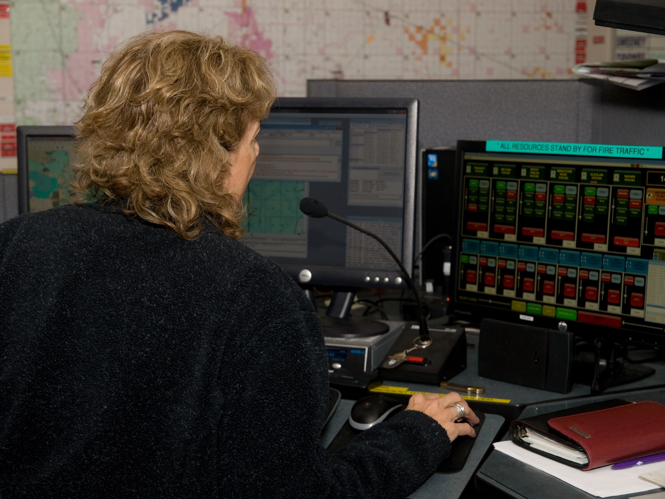
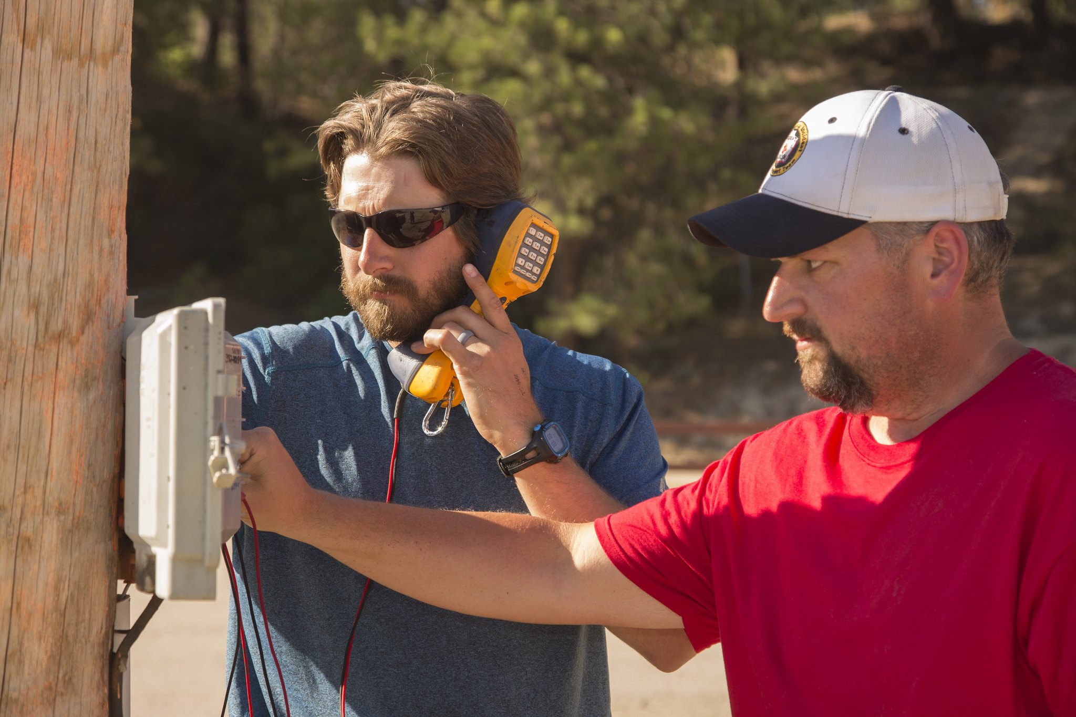
EDSD Main Responsibilities
Communication
Internal entities
External entities
Notes:
Communications Are Essential For Firefighters | Communicatio… | Flickr
Dispatchers Communicate with Firefighters | Dispatchers work… | Flickr

Slide 26
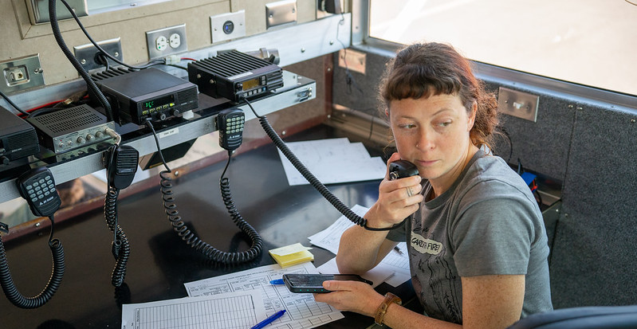
Activity: Communication
Notes:
Caldor Fire | The Tahoe Helitack Crew provides support to th… | Flickr

Slide 27
EDSD Main Responsibilities
Document
Complete all administrative tasks and documentation in an accurate and timely manner.
Demobilize
Prepare for and implement demobilization.

Slide 28
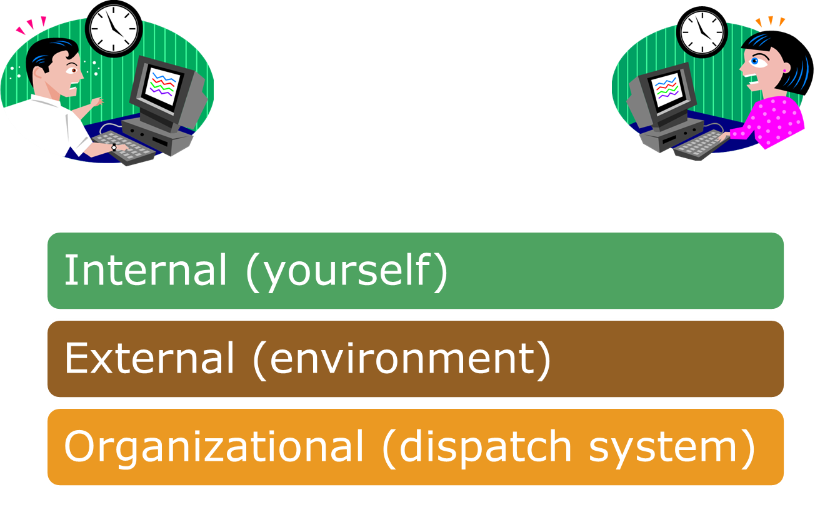
Managing Stress

Slide 29
Summary
The expanded dispatch organization consists of the following positions: EDSP, EDSD, and EDRC.
Expanded dispatch plays a crucial role in planning, organizing, and implementing a functional area (e.g., aircraft, supplies, equipment, overhead, crews) to meet the needs of an incident.
EDSDs may or may not be guiding EDRCs. Each assignment – and your authority – will be different.
You are expected to be proficient in the functional area to which you are assigned.
EDSDs are expected to work productively in stressful environments. You cannot always control a situation, but you can control how you react to it.

